Slide 2
Darwin Rivera
Project Step 8
Application: SetSell
March/13/2019

Slide 3
GOAL
Application where all users can trust the items they buy is exactly what they were promised

Slide 4
TARGET USER
People looking to buy items
People who are just looking

Slide 5
Buying with confidence
All photos are verified
All items are verified

Slide 6
How I plan to do this
We coordinate everything
All personal information will be encrypted
Notes:
I want to keep communication direct from users to us and all information from both the users and the products be stored in a database.
I’ve researched several types of encryption and planned on using encryption only on establishing the account but will also have to have it when the invoice is sent out the user making a purchase.
Also will need encryption from admin section to the database itself since its personal information and needs to be secured on all sides.

Slide 7
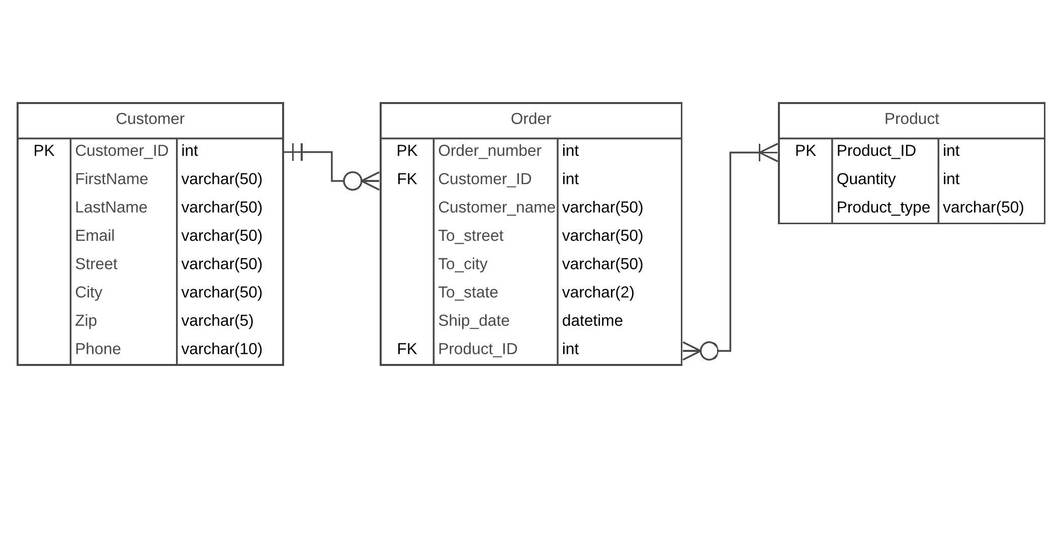
ERD
Notes:
Please see revised ERD.

Slide 8
SQL SCRIPTS
CREATE TABLE [Order] (
[Order_number] int,
[Customer_ID] int,
[Customer_name] varchar(50),
[To_street] varchar(50),
[To_city] varchar(50),
[To_state] varchar(2),
[Ship_date] datetime,
[Product_ID] int,
PRIMARY KEY ([Order_number])
);
CREATE INDEX [FK] ON [Order] ([Customer_ID], [Product_ID]);
CREATE TABLE [Customer] (
[Customer_ID] int,
[FirstName] varchar(50),
[LastName] varchar(50),
[Email] varchar(50),
[Street] varchar(50),
[City] varchar(50),
[Zip] varchar(5),
[Phone] varchar(10),
PRIMARY KEY ([Customer_ID])
);
CREATE TABLE [Product] (
[Product_ID] int,
[Quantity] int,
[Product_type] varchar(50),
PRIMARY KEY ([Product_ID])
);

Slide 9
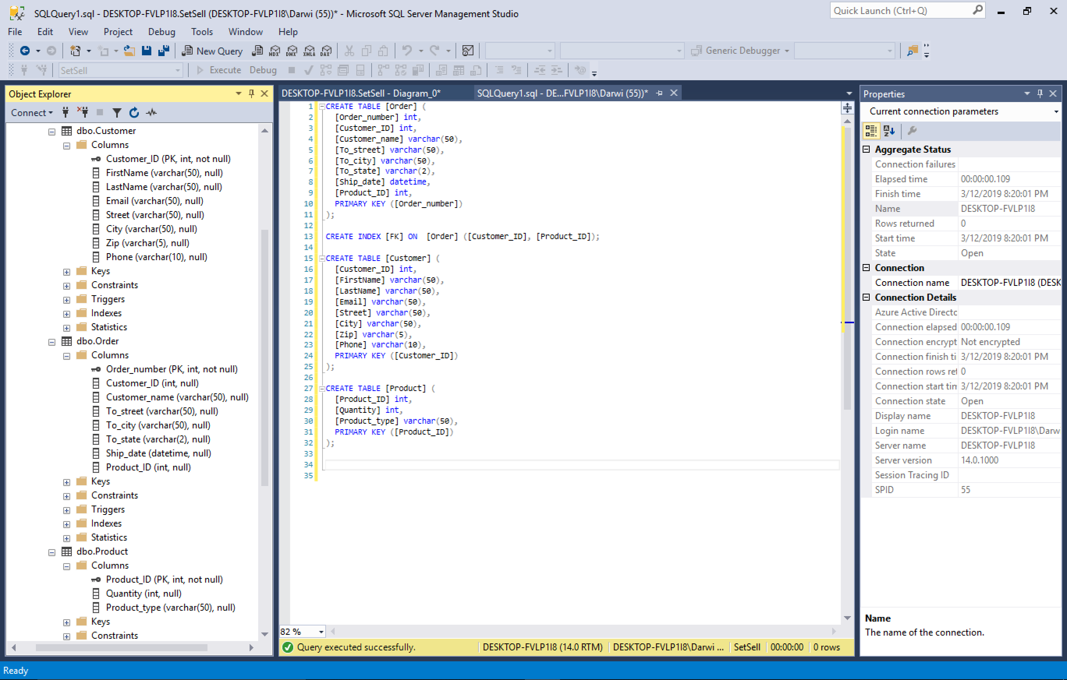

Slide 10
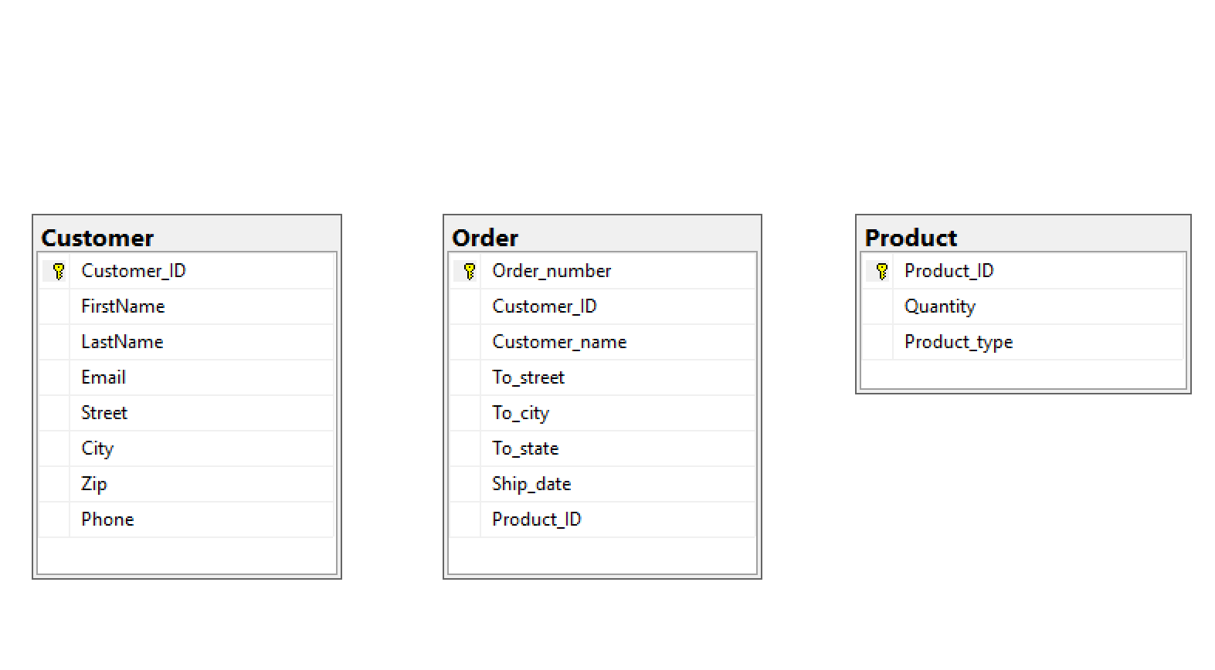

Slide 11
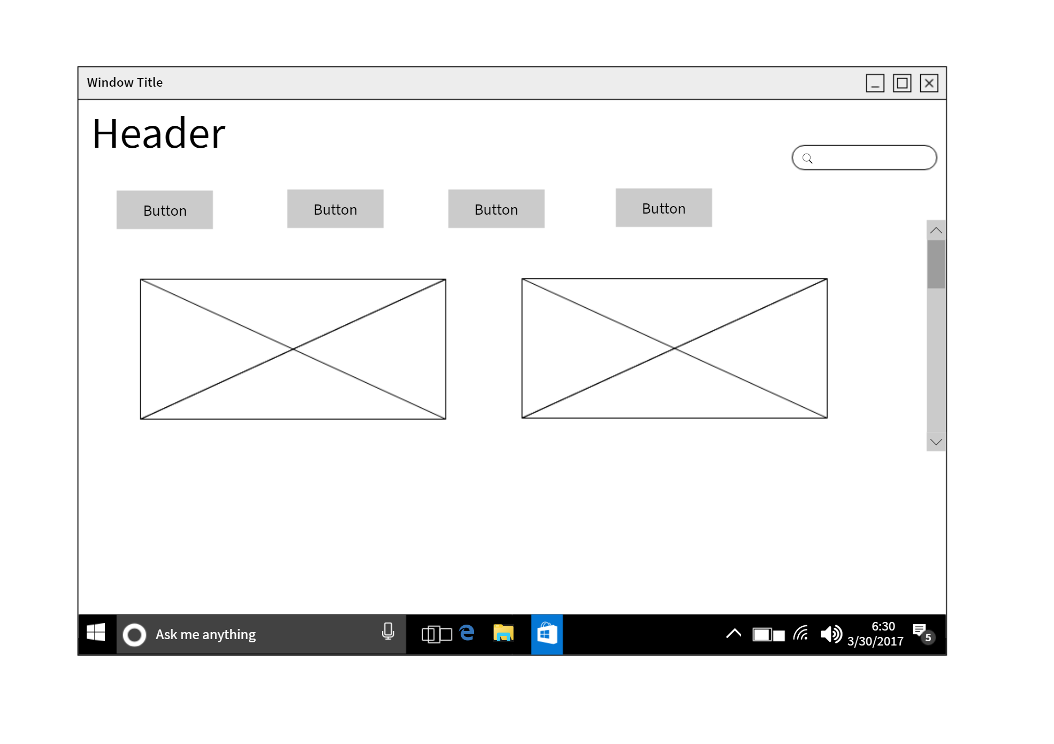
Design

Slide 12
What makes us different
No “low - balling”
No uncomfortable meetings in public or travel involved
No unnecessary conversations
Price matching

Slide 13
SQL SCRIPTS
https://github.com/DarwinRivera1

Slide 14
QUESTIONS ???

